Slide 1

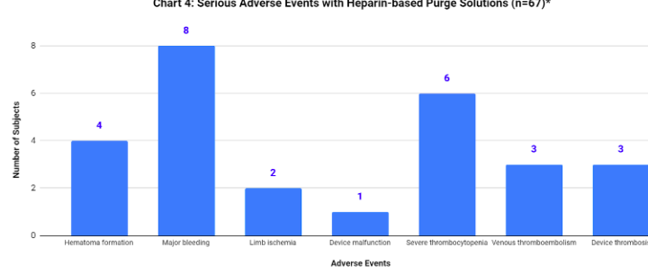
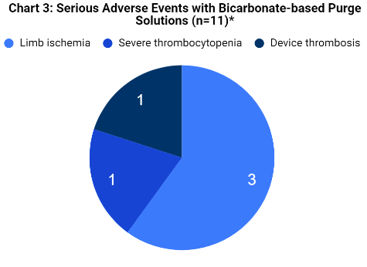
Retrospective analysis of purge solutions for left ventricular
assist devices in patients with cardiogenic shock
Ascension St. Vincent’s
1 Shircliff Way
Jacksonville, FL 32205
Isabel Jacobs, PharmD
PGY2 Critical Care Pharmacy Resident
isabel.jacobs@ascension.org
Isabel Jacobs, PharmD; Bryan Allen, PharmD, BCCCP, BCIDP; Rochelle Forsyth, PharmD, BCPS
The authors have no conflict of interest.
Background
Results
Discussion
Cardiogenic shock is characterized by decreased cardiac output leading to organ hypoperfusion with an in-hospital mortality of nearly 40%¹
Percutaneous left ventricular assist devices such as ImpellaⓇ implanted device augments circulatory support²
ImpellaⓇ manufacturer recommends heparinized purge solution in dextrose 5% in water (D5W) with intravenous unfractionated heparin (UFH) systemic anticoagulation²
Data shows only 8–52% of 65 hospital medical centers follow manufacturer recommendations³
Considerable variability in local prescribing practices, cardiogenic shock electronic prescribing orderset developed to standardize purge selection and reduce adverse event risk
Direct thrombin inhibitors such as bivalirudin and sodium bicarbonate 25 mEq in 1000 mL D5W have been used as alternative purge solutions^{5,6}
Preferred purge solution changed to sodium bicarbonate 25 mEq in 1000 mL D5W in new cardiogenic shock orderset to standardize local practice
Table 1: Baseline Demographics
Characteristic | Result (n=80)
Mean age, years | 66.26
Male subjects | 60 (75)
Impella® indication CABG/PCI Post-ROSC STEMI nSTEMI Other | 27 (34) 16 (20) 15 (19) 14 (17) 8 (10)
Baseline LVEF, % | 25 (15)
Mean hemoglobin, g/dL | 12.9
Systemic anticoagulation Heparin 25000 units Argatroban Bivalirudin None | 55 (68) 3 (4) 2 (2) 20 (25)
Table 2: Clinical Outcomes of Impella Use
Outcome | Result (n=80)
Mean duration of Impella® use, days | 2.5
Increase in LVEF, % | 3 (5)
Reasoning for change purge pressure or rate No change or undocumented reason Decrease/weaning for explant Increase due to lack of cardiac output Increase due to device malfunction | 32 (40) 28 (35) 18 (22.5) 2 (2.5)
Percentage of time within aPTT goal range, % | 26.1 (26.6)
Mean LDH level, g/dL | 1475.3
Mortality rate | 29 (36)
aPTT goals for systemic anticoagulation, s 50-70 60-90 N/A | 1 (1) 56 (70) 23 (29)
Mean hemoglobin decrease during Impella®, g/dL Bicarbonate purge solution (n=11) Heparin purge solution (n=67) | 4.0 5.0 3.8
Results are too minimal to draw a substantial conclusion of the effects of purge solutions on thrombi formation, do incite further evaluation
In previous studies, change in purge pressure was surrogate measure for device complications or device failure⁴
Purge pressure changes were collected, due to incomplete charting full conclusion was not able to be completely determined
Subjects with increased concentrations of bicarbonate in purge solution had increased rates of device thrombosis and limb ischemia, limited due to small subgroup size (n=11)
Rates of hemolysis were equal in both heparinized- and bicarbonate-based purge solutions
Stringent monitoring of signs and symptoms of major bleeding should be utilized
Conclusion
Objective
Future evaluation of ImpellaⓇ-related bleeding and thrombotic risks are warranted
Investigation can be used as baseline to compare post-orderset outcomes
Despite systemic anticoagulation, thrombotic events were noted in the lower dose heparin-based purge solution concentrations (12000 unit and 12500 unit)
Lower aPTT goals may be utilized to adjust for the ImpellaⓇ purge solution and hemolytic effect of pump such as 55-80 s based on manufacturer recommendation
May reduce variability in prescribing patterns and adverse events risk with new orderset standardized purge solution
To evaluate previous prescribing patterns of various purge solutions and their potential impact on adverse event rates in cardiogenic shock patients with ImpellaⓇ usage.
All values are reported as median or n (%) unless otherwise noted
Methods
Chart 1: Serious Adverse Events with Heparin-based Purge Solutions (n=67)*
Chart 2: Serious Adverse Events with Bicarbonate-based Purge Solutions (n=11)*
8
8
Study Design | Retrospective, observational
Subjects (n=80) | Identified by medication administration records
Time Frame | September 1st, 2020 to September 1st, 2022
Hospital location | St. Vincent’s Riverside, Southside, Clay
Inclusion Criteria | All ImpellaⓇ recipients age ≥ 18 years
Exclusion Criteria (n=6) | Incomplete medical record data
6
6
Number of Subjects
4
4
3
3
2
2
References
1
1. BMJ Open. 2019;9(5):e025734. 2. Pharmacotherapy.
2021;41(11):932-942. 3. J Thromb Thrombolysis.
2019;48(2):284-291. 4. Circ Heart Fail. 2013;6(1):23-30.
5. Heparin-free purge: Bicarbonate-based Purge Solution.
Heparin-Free Purge: Bicarbonate-Based Purge Solution|
HeartRecoverycom. 6. Ann Pharmacother.
2022;10600280221124156.
0
Hematoma formation
Major
bleeding
Limb ischemia
Device malfunction
Severe
thrombocytopenia
Venous
thromboembolism
Device
thrombosis
*One patient may have experienced more than one adverse event
All values are reported as median or n (%) unless otherwise noted
Adverse Events

